Slide 1
Notes:
Transition slide

Slide 2
Virtual Den Meetings
Virtual Meetings should still have a focus on fun and advancing Scouts to the next rank
In-person meeting plans can be modified for virtual
Virtual Meeting Considerations
Early and complete communication to parents
Material needs
Shorter activities to keep attention
Utilize the Scouting at Home videos and Den Leader Virtual Resources
For examples on how to do activities
To show parents what you will be trying
To show what materials you may need
Notes:
Discuss at a high level how a Virtual Meeting should still have a focus on Scout development and advancement. They don’t have to be just filler because they are virtual.
Put an emphasis on the value of communication to parents. Communication needs to be early enough for parents to plan and to see the value of the activity. Make plans for materials needed and how to get them to the Scouts. Options include:
-Having parents gather them themselves
-Have the Den gather them and deliver
-Have the Den gather them and make available for pickup

Slide 3
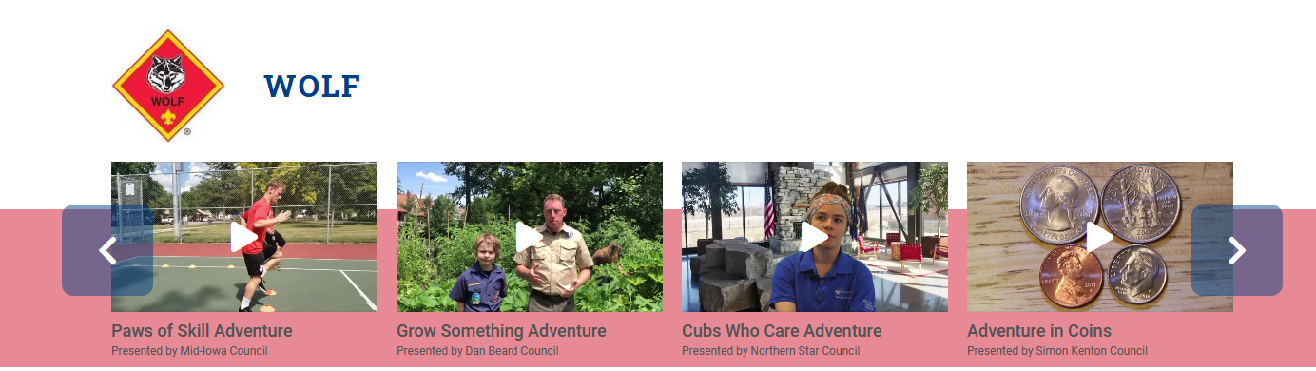
Den Leader Virtual Resources
https://www.scouting.org/programs/cub-scouts/den-meeting-resources/den-leader-tips-tricks-video-series/
Notes:
Short video helps were created for every Cub Scout Adventure this summer. These videos do not replace a den meeting but can help a Den build or instruct a virtual meeting. Many of the videos walk through some of the activities. Den leaders can watch these videos to get ideas, send them to parents to help explain how an activity will go, or show them in the Den meeting.
These videos are available to anyone at the link listed.

Slide 4
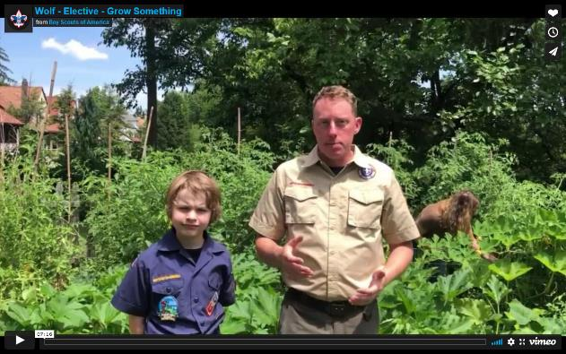
Example Virtual Den Meeting Plan
Wolf Elective - Grow Something
Opening (5 Minutes)
Pledge of Allegiance
Display a photo of video of the American Flag
Scout Oath and Law
Display the words if Scouts are newer
Talk Time ( 5 minutes)
Overview of the meeting
Den/Pack announcements
Den Activity (30 minutes)
Grow Something Requirement #1
Materials needed
Seeds & Soil
Container for planting
Water
Walk Scouts through planting a seed in a container and watering it
Utilize Grow Something video if desired/needed
Have then draw the first weekly drawing & explain that they should do this once a week for 30 days.
Closing (5minutes)
Quiet reflection on topic relevant to Scouts in the Den
Notes:
Virtual Den meetings should still have all the aspects of a normal meeting. Have an opening and a closing. Cover important announcements. Make sure Scouts understand what they have accomplished in the meeting with the activity.

Slide 5
Virtual Den Meeting Tips
Virtual Meetings may take more pre-planning than in-person meetings
Communicate the plan to parents at least a week in advance of the meeting to:
Allow parents to gather materials
Prepare to help Scouts with the activity
Get Scouts excited to participate
Plan how to distribute materials
Ask parents to gather on their own
Buy as a Den and deliver
Buy as a Den and ask parents to pick up
Practice teaching the activity remotely ahead of time
Notes:
Discuss at a high level how a Virtual Meeting should still have a focus on Scout development and advancement. They don’t have to be just filler because they are virtual.
Put an emphasis on the value of communication to parents. Communication needs to be early enough for parents to plan and to see the value of the activity. Make plans for materials needed and how to get them to the Scouts. Options include:
-Having parents gather them themselves
-Have the Den gather them and deliver
-Have the Den gather them and make available for pickup

